Slide 1
📂 Directory Size Calculator
By: Tanisha Dhopeshwar
Tools Used: Python, Tkinter, Git

Slide 2
🧠 Problem Statement
Design an application that simulates a file system with a hierarchical structure of directories and files.
Requirements
Support common shell commands: cd, ls, and size
Recursively compute folder sizes
Keep everything in memory (no database)
Optional UI (implemented using Tkinter)

Slide 3
🏗️ Design and Approach
Core Design:
File class: holds name and size
Directory class:
List of files
Dictionary of subdirectories
Parent pointer for navigation
get_size() method uses recursion
Smart Optimization:
Added size caching for fast repeated access

Slide 4
🧪 Features & Functionality
Command-Line Interface:
ls: List contents
cd <folder>: Change directory
Size: Total size of current directory
size <folder>: Size of a specific subfolder
exit, help
Graphical User Interface:
Folder and file listing
Navigate via double-click
'Show Size' and 'Go Back' buttons

Slide 5
🚀 How to Run
CLI Version
Clone the repo
Run: python main.py
GUI Version
Ensure main.py and gui.py are in the same folder
Run: python gui.py
Repo Includes:
main.py: CLI app
gui.py: Tkinter GUI
README: Instructions + feature list

Slide 6
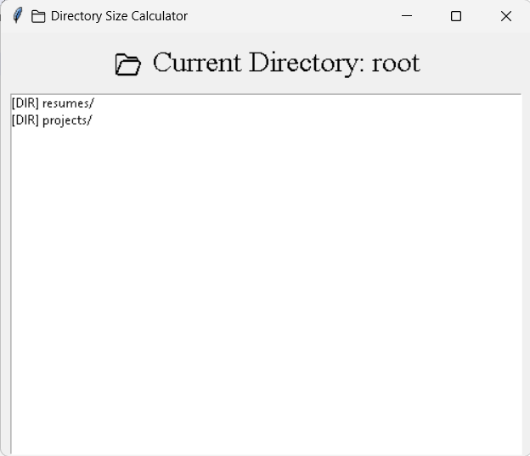
GUI App Preview

Slide 7
Thank You!

